Slide 1
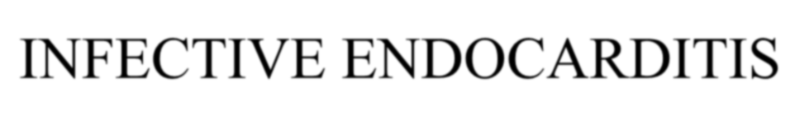
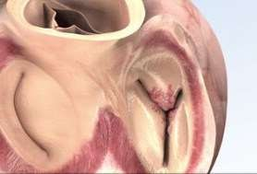
INFECTIVE ENDOCARDITIS
DR.K.N.KARTHIC SUMAN NATH

Slide 2
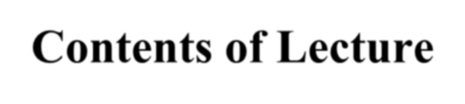












Contents of Lecture
Endocarditis
  Definitions
  Epidemiology
  classification
  Pathogenesis
  Clinical Presentations
  Diagnosis
  Complications
  treatment
  prophylaxis

Slide 3
















DEFINITION
Infective Endocarditis (IE) is a microbial infection of the endocardial (endothelial) surface of the heart.
The vegetation is a variably sized amorphous mass of platelets and fibrin in which abundant micro-organisms and scant inflammatory cells are enmeshed.
Braunwald – Heart Disease

Slide 4
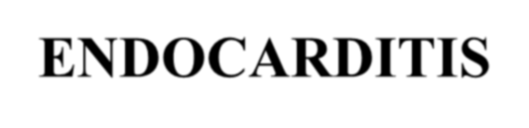
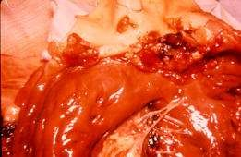
ENDOCARDITIS
Characteristic pathological lesion: vegetation, composed of platelets, fibrin, microorganisms and inflammatory cells.

Slide 5
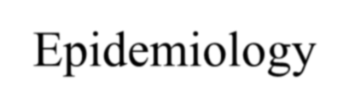








Epidemiology
Incidence difficult to ascertain and varies according to location
Much more common in males than in females
May occur in persons of any age and increasingly common in elderly
Mortality ranges from 20-30%

Slide 6














Classification
Acute
  Affects normal heart valves
  Rapidly destructive
  Metastatic foci
  Commonly Staph.
  If not treated, usually
fatal within 6 weeks
Subacute
  Often affects damaged heart valves
  Indolent nature
  If not treated, usually fatal by one year

Slide 7
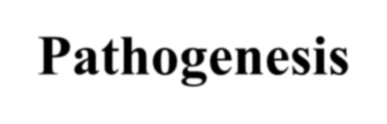
















Pathogenesis
ALTERED VALVE SURFACE
  Animal experiments suggest that IE is almost impossible to establish unless the valve surface is damaged
DEPOSITION OF PLATELETS AND FIBRIN –
nonbacterial thrombotic vegetation (NBTE)
BACTERAEMIA – attaches to platelet-fibrin deposits
  Covered by more fibrin
  Protected from neutrophils
  Division of bacteria
  Mature vegetation

Slide 8
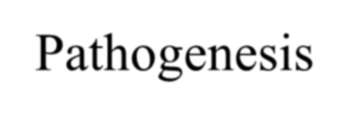









Pathogenesis
Haemodynamic Factors
  Bacterial colonisation more likely to occur around lesions with high degrees of tubulence
» eg. small VSD, valvular stenosis
  Large surface areas, low flow and low turbulence are less likely to cause IE
» eg large VSD,

Slide 9
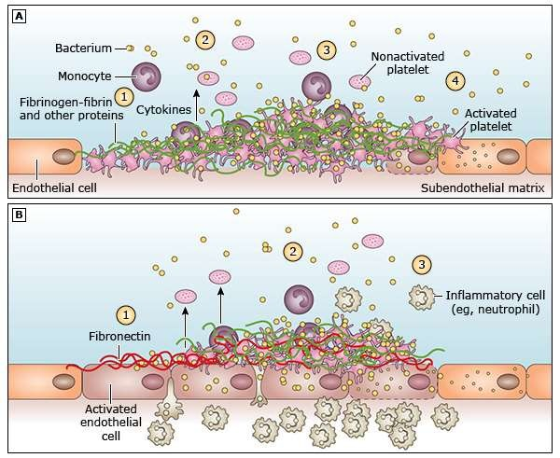

Slide 10









Pathogenesis
Bacteraemia
– Transient bacteraemia occurs when a heavily colonised mucosal surface is traumatised
» Dental extraction
» Periodontal surgery
» Tooth brushing
» Tonsillectomy
» Operations involving the respiratory, GI or GU tract mucosa
» Oesophageal dilatation
» Biliary tract surgery

Slide 11
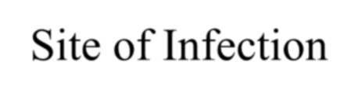








Site of Infection
Aortic valve more common than mitral
Aortic:
  Vegetation usually on ventricular aspect, all 3 cusps usually affected
  Perforation or dysfunction of valve
  Root abscess
Mitral:
  Dysfunction by rupture of chordae tendinae

Slide 12
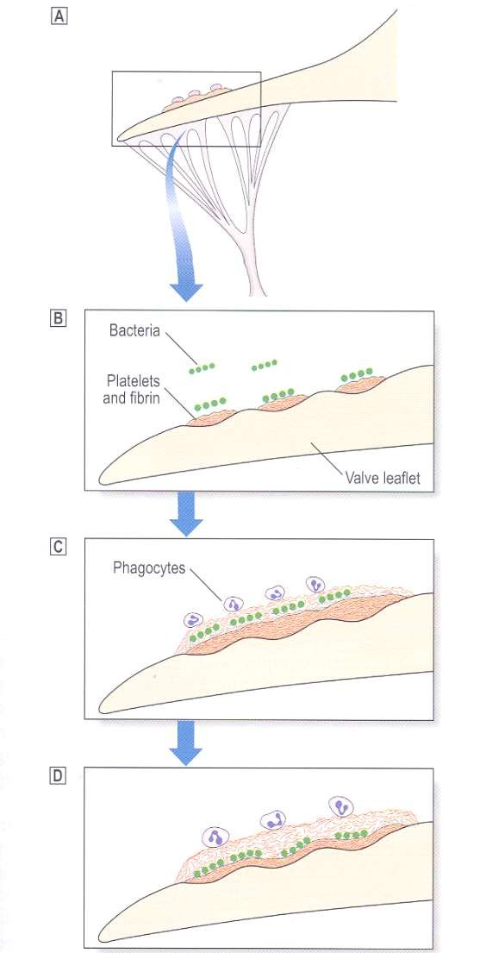
Turbulent blood flow traumatises endothelium
Nonbacterial thrombotic endocarditis
Bacteraemia
Further deposition of fibrin and platelets

Slide 13
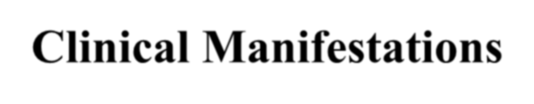













Clinical Manifestations
Fever, most common symptom, sign
Anorexia, weight-loss, malaise, night sweats
Heart murmur
Petechiae on the skin, conjunctivae, oral mucosa
Splenomegaly
Right-sided endocarditis is not associated with peripheral emboli/phenomena but pulmonary findings predominate

Slide 14

CLINICAL MANIFESTATION
SYMPTOMS | PERCENT | SIGNS | PERCENT
Fever | 80-95 | Fever | 80-90
Chills | 42-75 | Murmur | 80-95
Sweats | 25 | Changing/new | 10-40
Anorexia | 25-55 | murmur
Weight loss | 25-35 | Neurological | 30-40
Malaise | 25-40 | abnormalities
Dyspnea | 20-40 | Embolic event | 20-40
Cough | 25 | Splenomegaly | 15-50
Stroke | 13-20 | Clubbing | 10-20
headache | 15-40 | Peripheral | 10-20
Nausea/vomiting | 15-20 | manifestation
myalgia/arthralgia | 15-30 | Osler’s nodes | 7-10
Chest pain | 8-35 | Splinter hemorrhage | 5-15
Abdominal pain | 5-15 | Petechiae
Back pain | 7-10 | Janeway’s lesions | 10-40
confusion | 10-20 | Retinal lesion | 6-10
 |  |  | 4-10

Slide 15



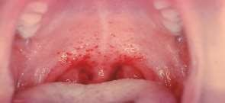

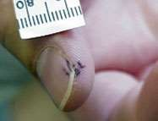




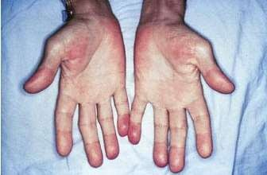





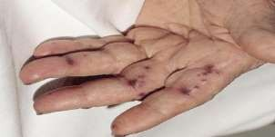


Petechiae—Nonspecific
Splinter Hemorrhages Nonspecific
Osler’s Nodes--More specific Painful and erythematous nodules
Janeway Lesions
More specific,Nonpainful

Slide 16
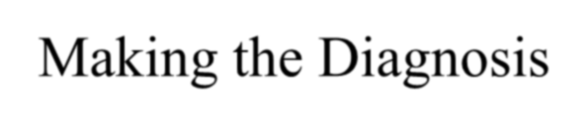
Making the Diagnosis

Slide 17
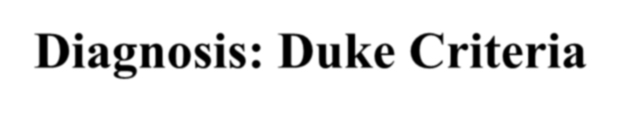









Diagnosis: Duke Criteria
In 1994 a group at Duke University standardised criteria for assessing patients with suspected endocarditis
Include
-Predisposing Factors
-Blood culture isolates or persistence of bacteremia
-Echocardiogram findings with other clinical, laboratory findings

Slide 18
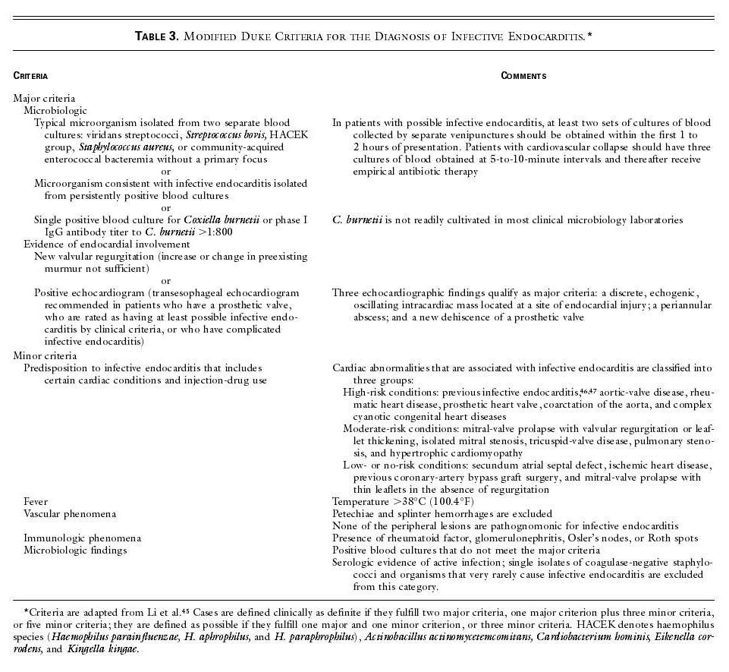

Slide 19
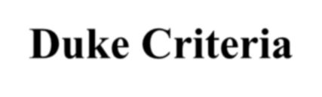














Duke Criteria
Definite
: 2 major criteria
: 1 major and 3 minor criteria
: 5 minor criteria
: pathology/histology findings
Possible : 1 major and 1 minor criteria
: 3 minor criteria
Rejected : firm alternate diagnosis
: resolution of manifestations of IE with 4 days antimicrobial therapy or less

Slide 20
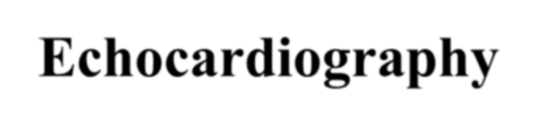

















Echocardiography
Trans Thoracic Echocardiograpy (TTE)
  rapid, non-invasive – excellent specificity (98%) but
poor sensitivity
  obesity, chronic obstructive pulmonary disease and chest wall deformities
Transesophageal Echo (TOE)
  more invasive, sensitivity up to 95%, useful for prosthetic valves and to evaluate myocardial invasion
  Negative predictive valve of 92%

Slide 21
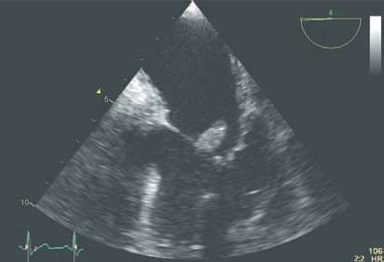

Slide 22
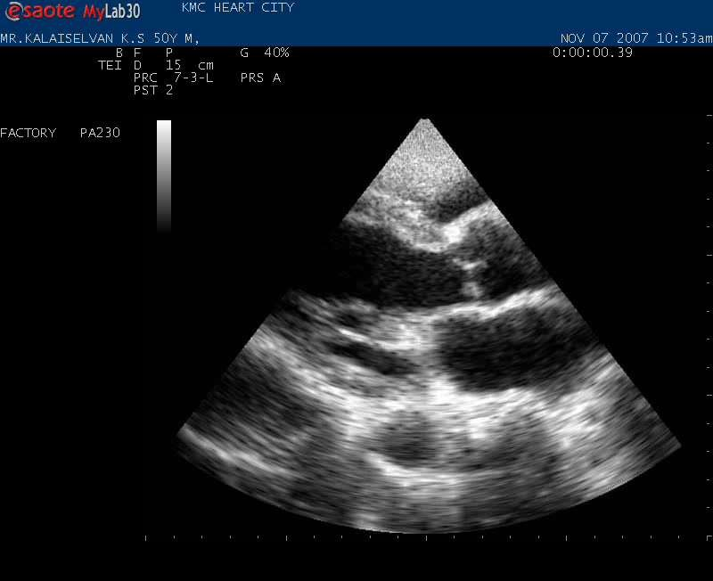

Slide 23
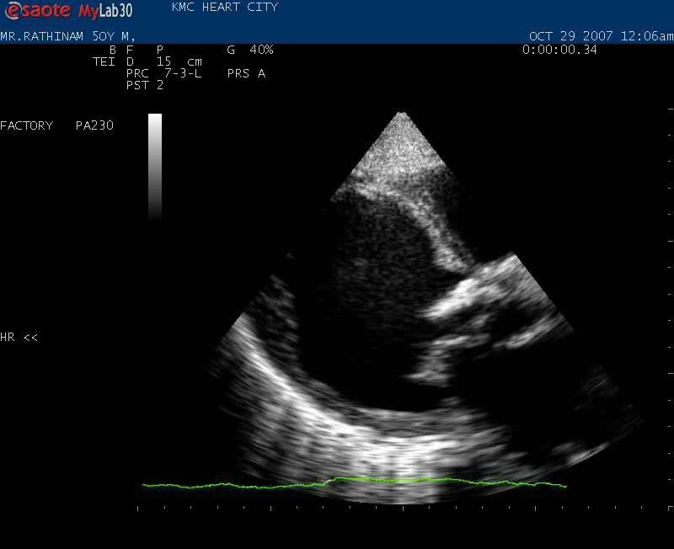

Slide 24
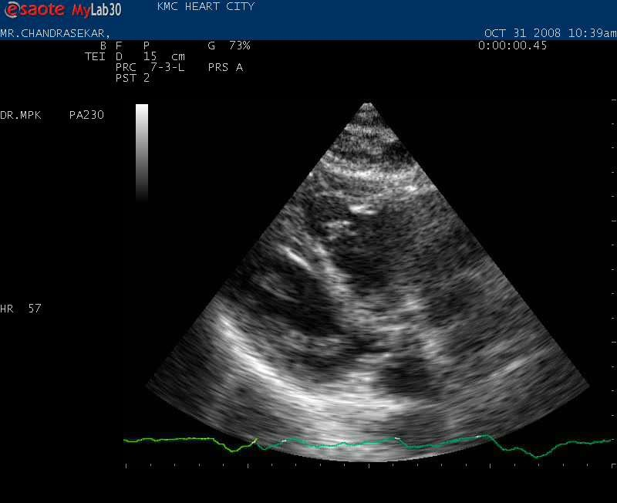

Slide 25
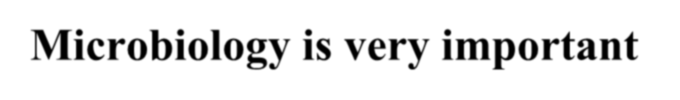
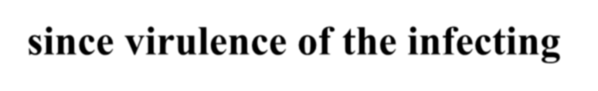
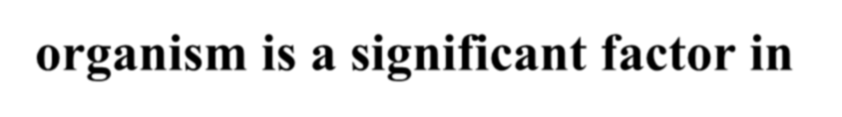
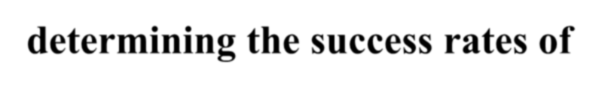
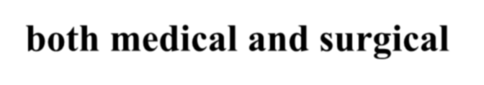
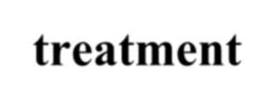
Microbiology is very important since virulence of the infecting organism is a significant factor in determining the success rates of both medical and surgical treatment

Slide 26
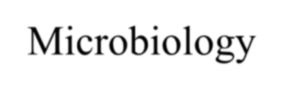
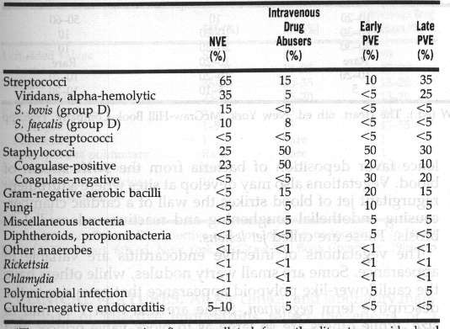
Microbiology
sx’s<60 d post

Slide 27
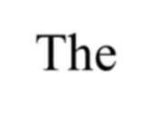
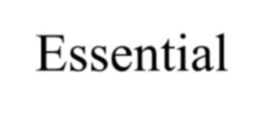
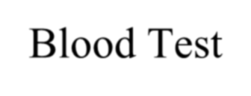
















The Essential Blood Test
Blood Cultures
  Minimum of three blood cultures
  Three separate venipuncture sites
  Obtain 10-20mL in adults and 0.5-5mL in children²
Positive Result
  Typical organisms present in at least 2 separate samples

Slide 28
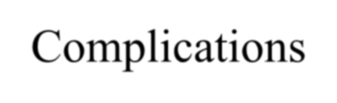







Complications
Four etiologies
  Embolic
  Local spread of infection
  Metastatic spread of infection
  Formation of immune complexes – glomerulonephritis and arthritis

Slide 29
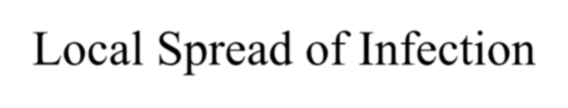
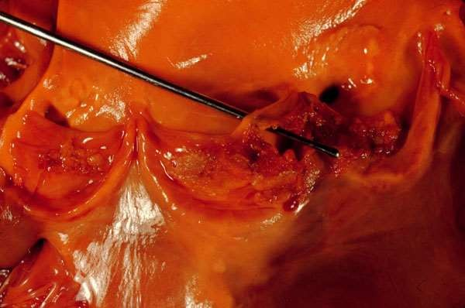
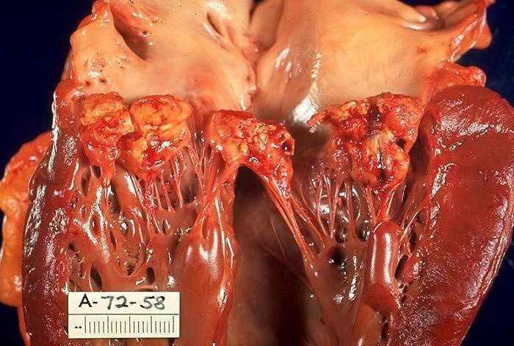
Local Spread of Infection
Acute S. aureus IE with perforation of the
aortic valve and aortic valve vegetations.
Acute S. aureus IE with mitral
valve ring
abscess extending into myocardium.

Slide 30
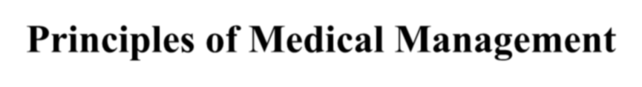











Principles of Medical Management
Sterilization of Vegetations with antibiotics
- prolonged
Slowly metabolising bacteria
due to high density, hence ↓
sensitivity
- high dose
Bacteria deep inside vegetations
-bactericidal

Slide 31
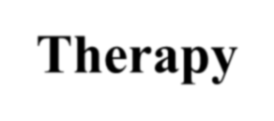









Therapy
Streptococci/Enterococci
  Determine MIC of Penicillin
  Penicillin +/- aminoglycoside
  Ceftriaxone alone
  Vancomycin +/- aminoglycoside
HACEK group
– Cefotaxime/ceftriaxone

Slide 32
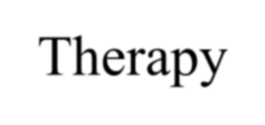









Therapy
Staphylococci
  Native valve
» Flucloxacillin +/- aminoglycoside
» Vancomycin +/- aminoglycoside/ rifampicin
  Prosthetic valve
» Flucloxacillin + aminoglycoside + rifampicin
» Vancomycin + aminoglycoside + rifampicin

Slide 33
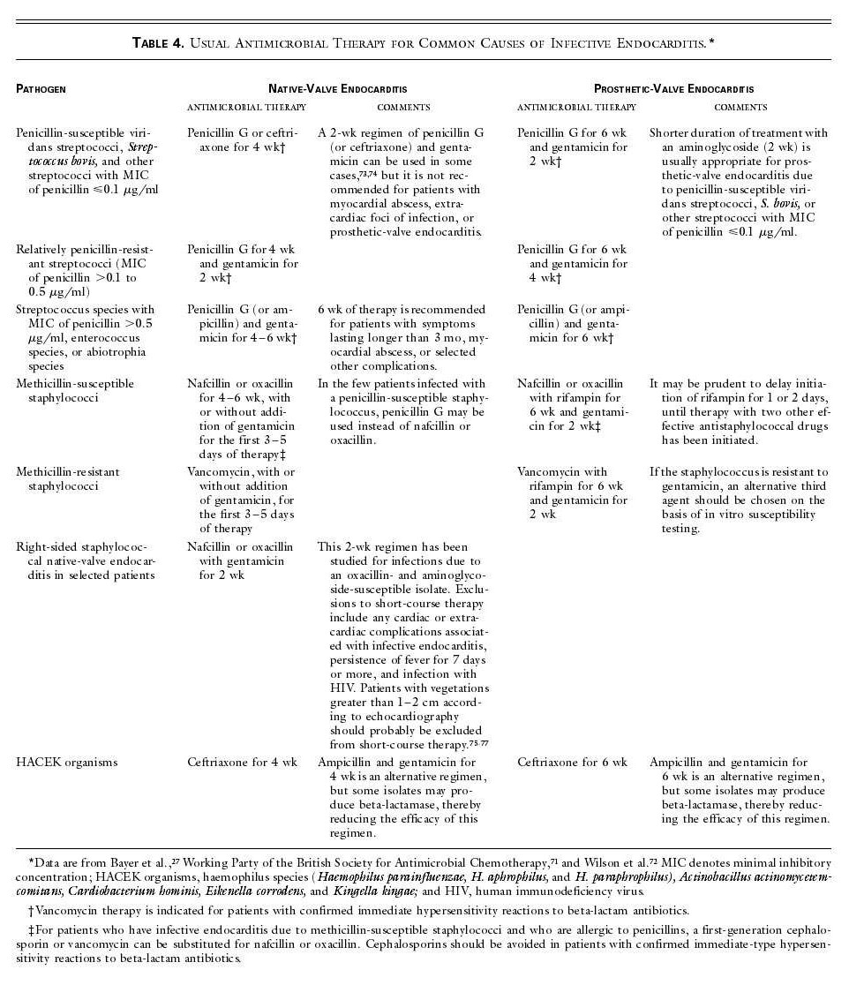

Slide 34
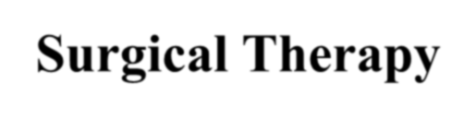










Surgical Therapy
Indications:
  Congestive cardiac failure
  perivalvular invasive disease
  uncontrolled infection despite maximal antimicrobial
therapy
  Presence of prosthetic valve endocarditis unless late infection
  Large vegetation
  Major embolus
  Heart block

Slide 35



Surgical Therapy
The hemodynamic status at the time determines principally operative mortality

Slide 36
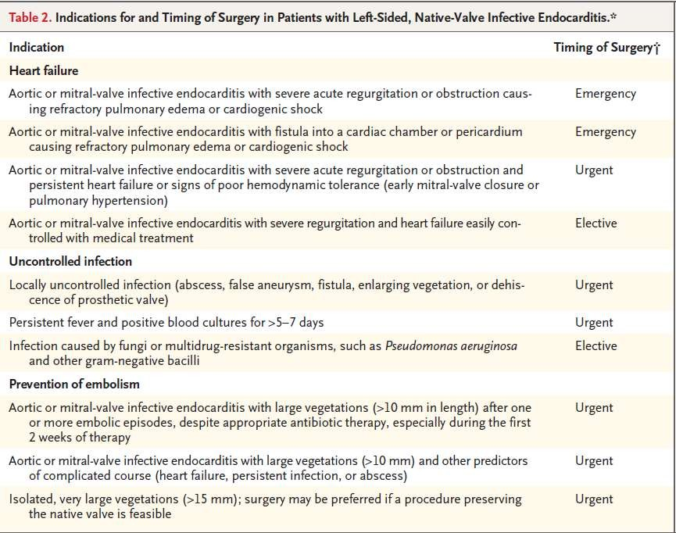

Slide 37








PROPHYLAXIS
The pathogenesis of infective endocarditis (IE) is presumed to involve the
following sequence of events
  Formation of a small thrombus on an abnormal endothelial surface
  Secondary infection of this nidus with bacteria that are transiently circulating in the bloodstream
  Proliferation of bacteria resulting in the formation of vegetations on the endothelial surface
Since the occurrence of bacteremia is crucial to the initiation of an episode of IE, in theory it is reasonable to conclude that preventing or promptly treating transient bacteremia can prevent the above events.

Slide 38



Evidence to support antimicrobial prophylaxis for prevention of endocarditis is weak
antimicrobial prophylaxis for patients with the highest risk medical conditions undergoing procedures likely to result in bacteremia with a microorganism that has the potential ability to cause bacterial endocarditis

Slide 39









HIGHEST RISK CONDITIONS
Prosthetic heart valves, including bioprosthetic and homograft valves
A prior history of IE
Unrepaired cyanotic congenital heart disease, including palliative shunts and conduits
Completely repaired congenital heart defects with prosthetic material or device, whether placed by surgery or by catheter intervention, during the first six months after the procedure
Repaired congenital heart disease with residual defects at the site or adjacent to the site of the prosthetic patch or prosthetic device
Valve regurgitation due to a structurally abnormal valve in a transplanted
heart

Slide 40






HIGHEST RISK PROCEDURES
Dental procedures that involve manipulation of either gingival tissue or the periapical region of teeth or perforation of the oral mucosa; this includes routine dental cleaning.
Procedures of the respiratory tract that involve incision or biopsy of the respiratory mucosa
Gastrointestinal (GI) or genitourinary (GU) procedures in patients with ongoing GI or GU tract infection
Procedures on infected skin, skin structure, or musculoskeletal tissue
Surgery to place prosthetic heart valves or prosthetic intravascular or
intracardiac materials

Slide 41












Antibiotic Regimens for Prophylaxis of Endocarditis in Adults with
High-Risk Cardiac Lesions
A. Standard oral regimen
1. Amoxicillin: 2 g PO 1 h before procedure
B. Inability to take oral medication
1. Ampicillin: 2 g IV or IM within 1 h before procedure
C. Penicillin allergy
1. Clarithromycin or azithromycin: 500 mg PO 1 h before procedure
2. Cephalexinc: 2 g PO 1 h before procedure
3. Clindamycin: 600 mg PO 1 h before procedure
D. Penicillin allergy, inability to take oral medication
1. Cefazolinc or ceftriaxonec: 1 g IV or IM 30 min before procedure
2. Clindamycin: 600 mg IV or IM 1 h before procedure

Slide 42
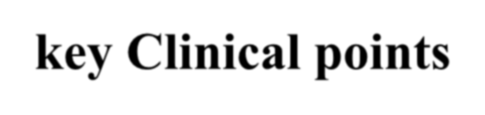







key Clinical points
Staphylococci and streptococci account for 80% of cases of infective endocarditis, with
staphylococci currently the most common pathogens.
Cerebral complications are the most frequent and most severe extracardiac complications. Vegetations that are large, mobile, or in the mitral position and infective endocarditis due to Staphylococcus aureus are associated with an increased risk of symptomatic embolism.
Identifying the causative microorganism is central to diagnosis and appropriate treatment; two
or three blood cultures should routinely be drawn before antibiotic therapy is initiated.
When infective endocarditis is suspected, echocardiography should be performed as soon as possible.
Indications for surgery include heart failure, uncontrolled infection, and prevention of embolic events.
Indications for antibiotic prophylaxis have been restricted to invasive dental procedures in patients with a prosthetic valve, a history of infective endocarditis, or unrepaired cyanotic congenital heart disease.

Slide 43
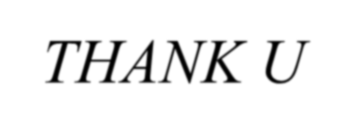
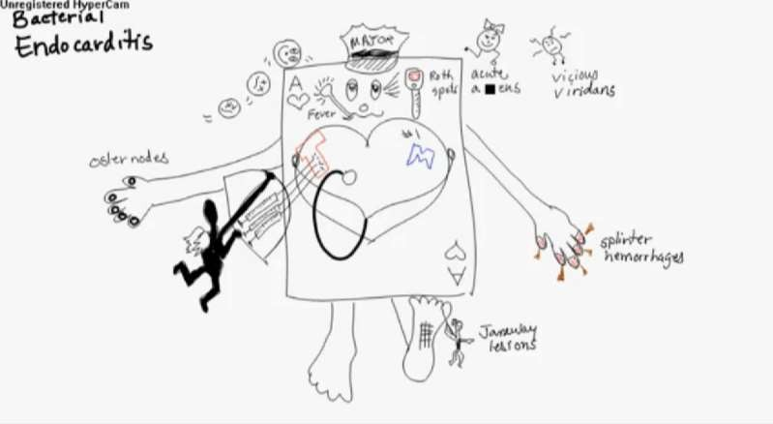

THANK U

